Slide 1
Fine Living Ecommerce
Group No. 10 Presented By:-
1015-Ankita Singh 1011-Akshay Shimpi
Guide Name:-
Mr. Milind Arjun

Slide 2
Introduction
A novel approach that provides, the user with E-Commerce website to order/request household services from various service providers.
Having nine categories present in the app – massage and fitness, appliance repair, home cleaning, moving homes, beauty and spa, painting and renovation, weddings and events, etc.
User and seller both can register on this platform.
Website offers various Payment options - COD, EMI, Credit card, Debit card & more.

Slide 3
introduction
It is an approach to overcome the issues faced during searching for household services and products by common people.
This system is proposed to overcome the flaws of the existing system and bridging the gap between consumer or user and service provider and provide hassle-free services.

Slide 4
Existing System
Existing system for household service is based on our traditional way of calling individual person or people for any kind of service
And this way led to many difficulties during the on going pandemic situation which started in year 2020.
Because of nation-wide shutdown people were unable to get this things done.
The proposed system helps in overcoming these difficulties and bridging the gap between consumer and service provider

Slide 5
Database Table
User table:
Column name | Data type | Key constraint
Object id | Varchar(30) | Primary key not null
Firstname | Varchar(30 | not null
Lastname | Char(20) | Not null
Username | Varchar(30) | Not null
Email | Varchar(30) | Not null
Password | Varchar(30) | Not null
Phone | Varchar(30) | Not null

Slide 6
Database Table
Products Table:
Column name | Data type | Key constraints | extra
Object id | Varchar(30) | Primary key not null | Auto increment
id | int | Foreign key Not null
URL | Char(100) | Not null
detailUrl | Char(100) | null
Title | Char(40) | Not NULL
Price | Double | Not null
Quantity | Int(10) | Not null
Description | Varchar(100) | Not null
Discount | Varchar(30)
Tagline | Varchar (30)

Slide 7
Requirements
Particulars | Client System | Server System
Operating System | Windows/Linux/Android/iOS | Linux
Processor | Intel or AMD | Intel or AMD
Hard Disk | 1 GB | 1 TB
RAM | 256 | 8GB

Slide 8
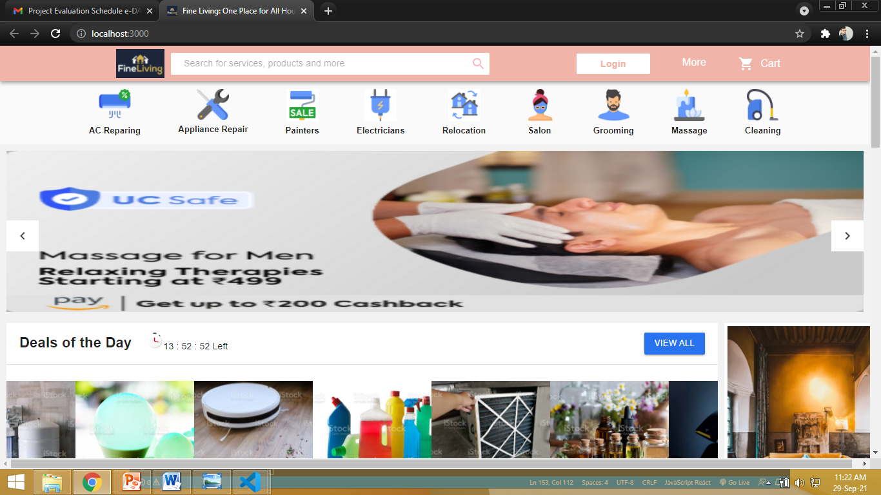
Snapshots

Slide 9
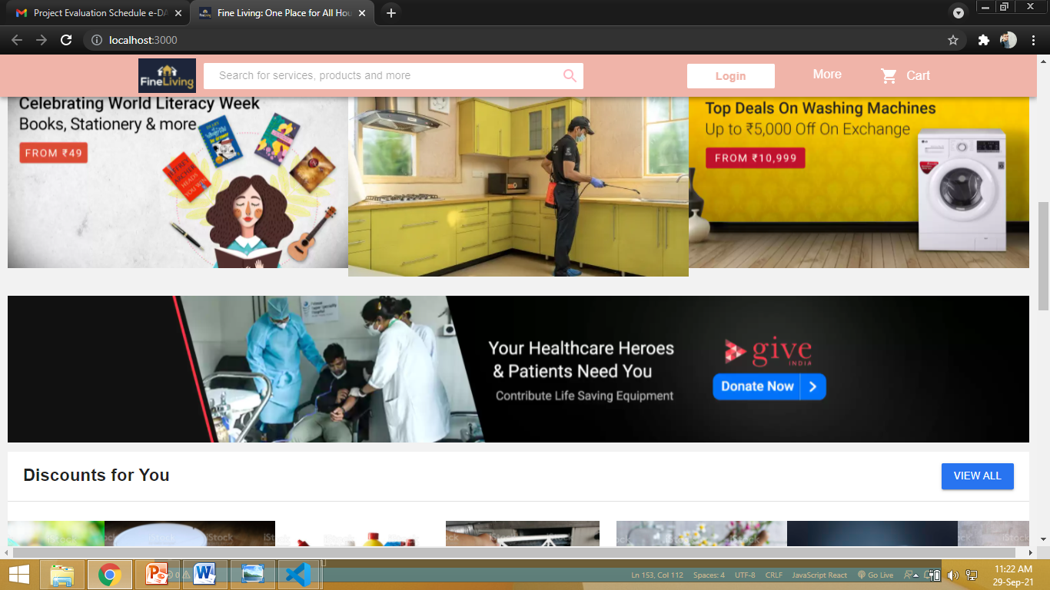
Snapshots

Slide 10
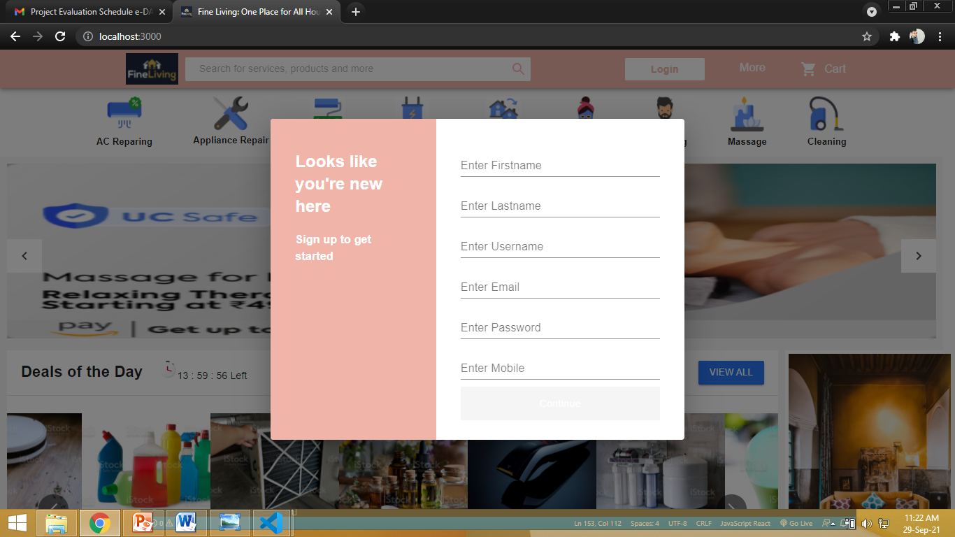
Snapshots

Slide 11
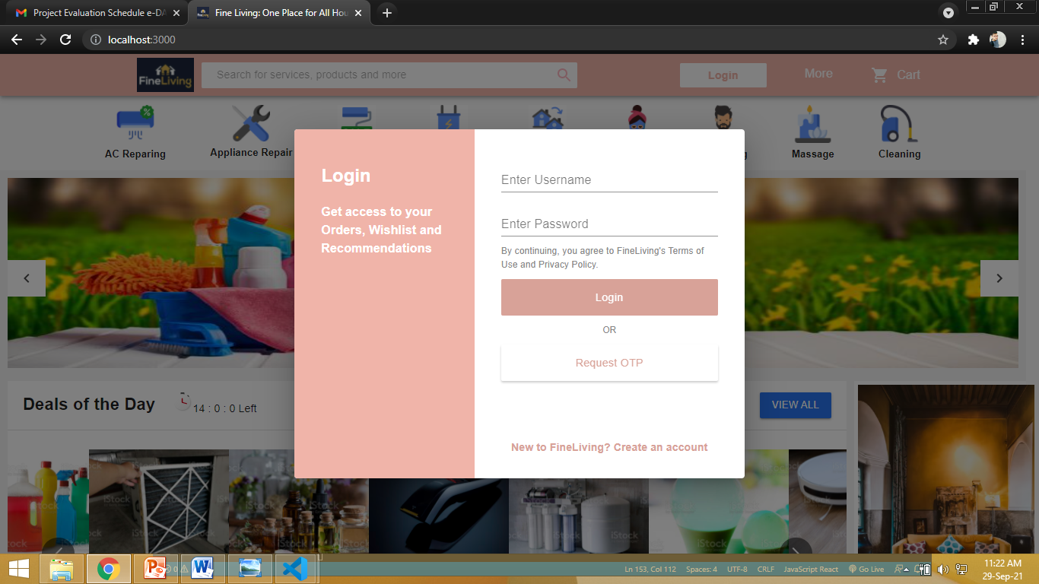
Snapshots

Slide 12
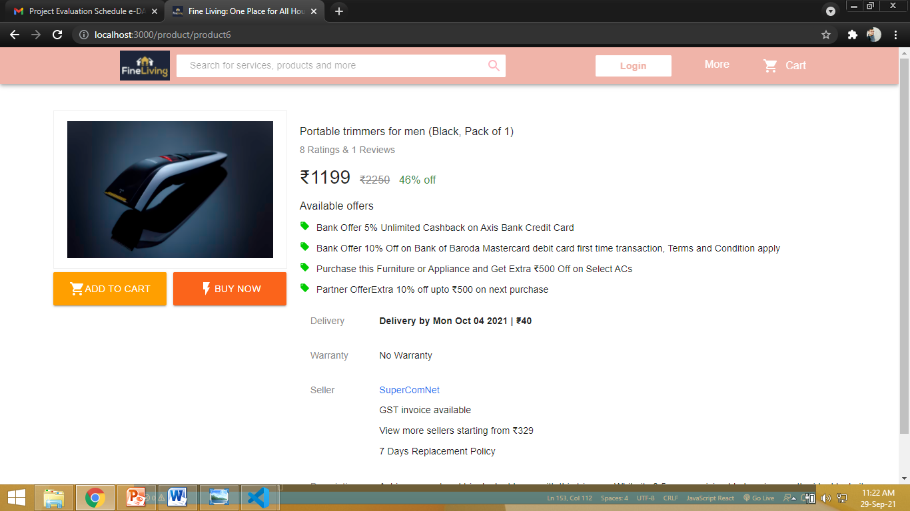
Snapshots

Slide 13
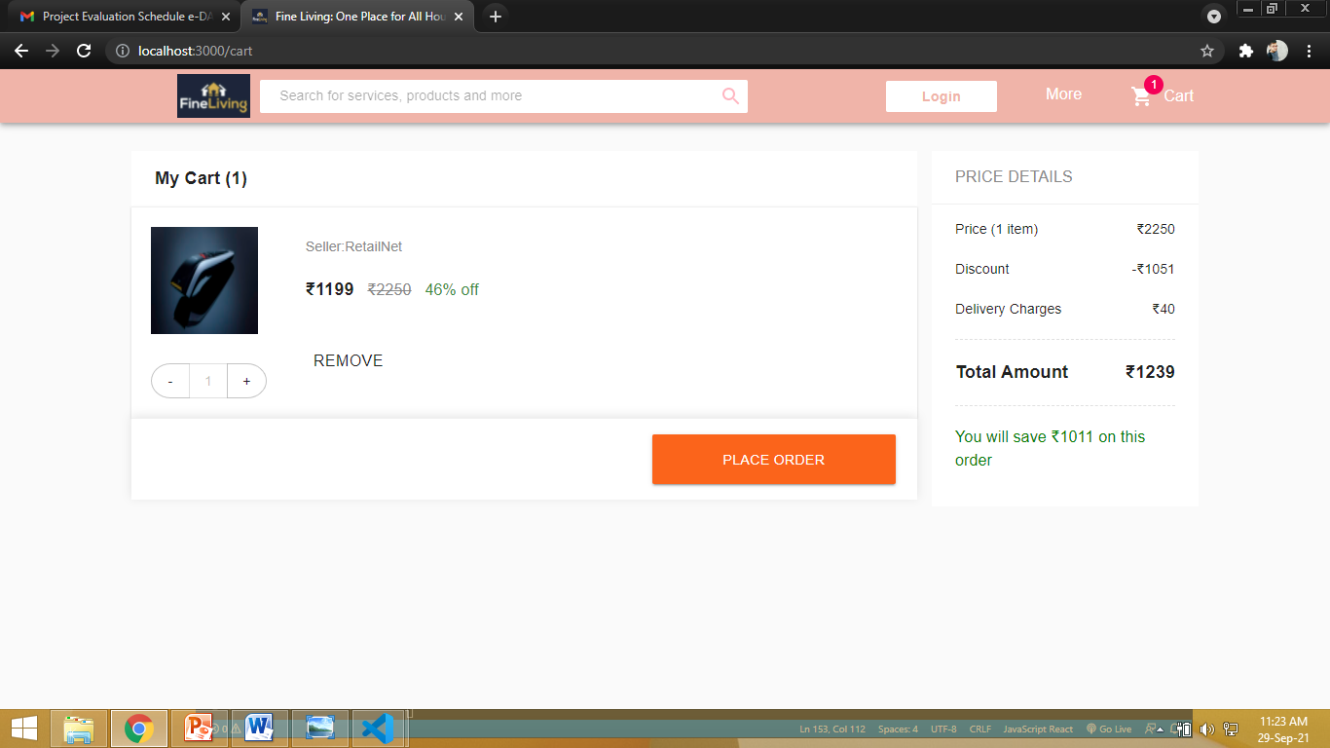
Snapshots

Slide 14
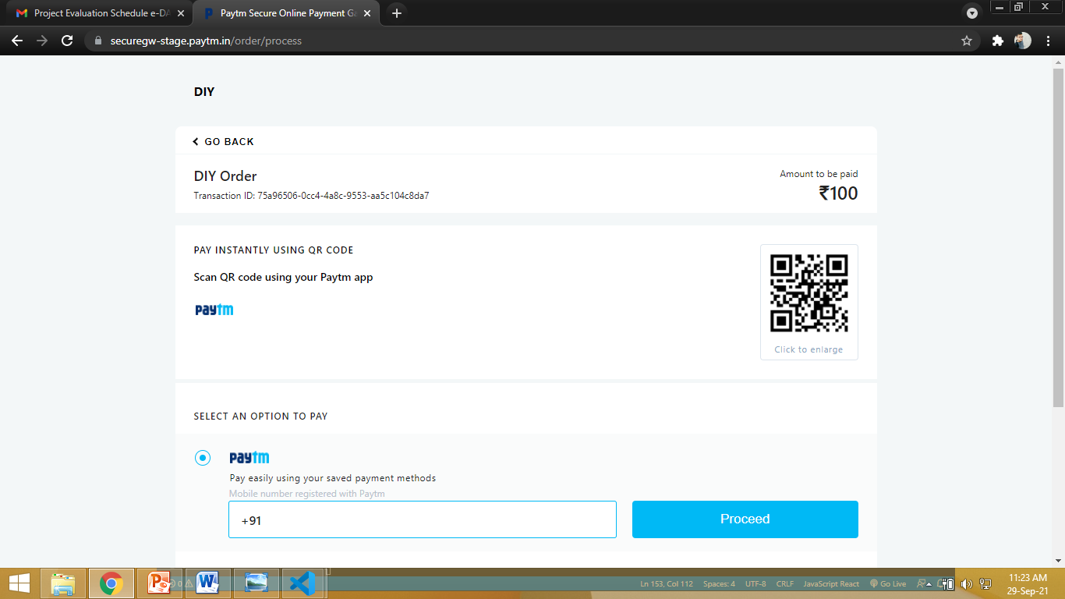
Snapshots

